Slide 1
ELEC3609/9609
Week 4 Lab Guide
Presented by
Jiawen Wen

Slide 2
A1 Milestone Reminder

Slide 3
Assignment 1
Milestone Reminder
A1 Milestone Submission: 02/09/2026, 11:59PM (Wednesday, Week 5). The submission portal on Canvas will open this weekend. This is a group submission, so only one submission is required per group.
Required PDFs (3 in total):
1. Group Contract
2. Presentation Slides
  Introduction; Background (market needs, problems); Idea/Solution; Prototyping (wireframes if possible); Team Introduction; Project Plan (Gantt Chart, frameworks)
  Reference: Airbnb first pitch desk
3. List of MVP Features
  One-page list with concise dot points
  Later adjustments allowed:
    Replace some MVP features -> update tutors.
    Adding “extra” MVP features -> no bonus marks, may lose marks for scope creep.
Note: I recommend starting your wireframes now. Revisiting your FRs and MVP list after sketching wireframes will help you refine what features are essential and identify gaps early.
Note: All team members must attend the Week 5 lab presentation, though only one needs to present. If you cannot attend, you must apply for special consideration under Assignment 1 and notify both the coordinators and tutors.

Slide 4
Django Architecture

Slide 5
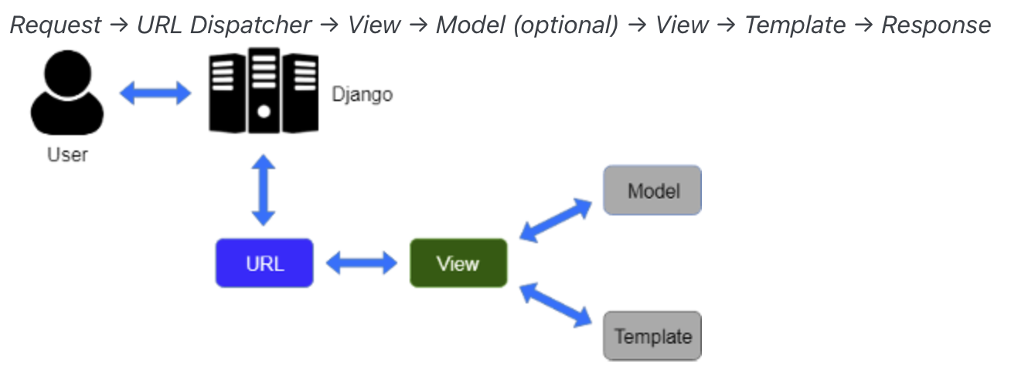
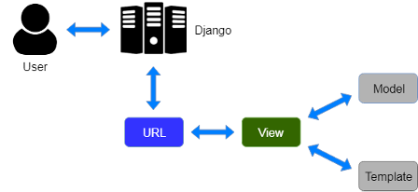
Django Architecture
Django MVT

Slide 6
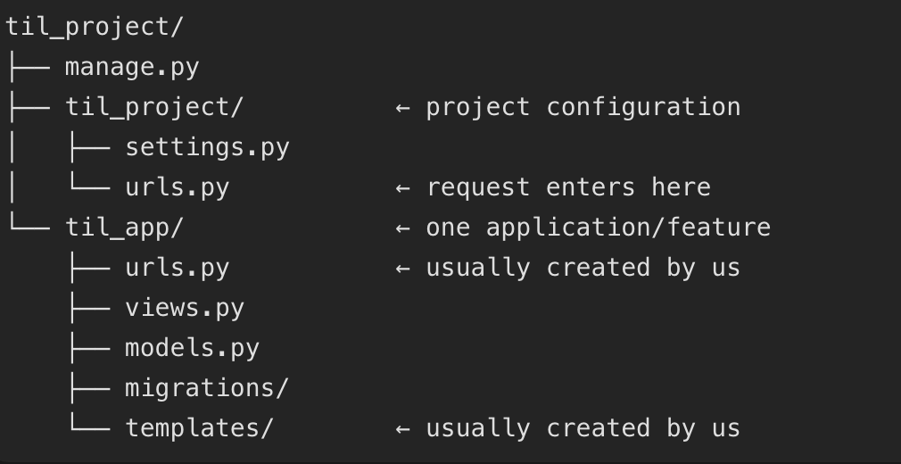
Django Architecture
Project Structure

Slide 7
AJAX

Slide 8

AJAX
Asynchronous JavaScript and XML
AJAX vs Full-Page Reload: Load More Demo @jsfiddle

Slide 9
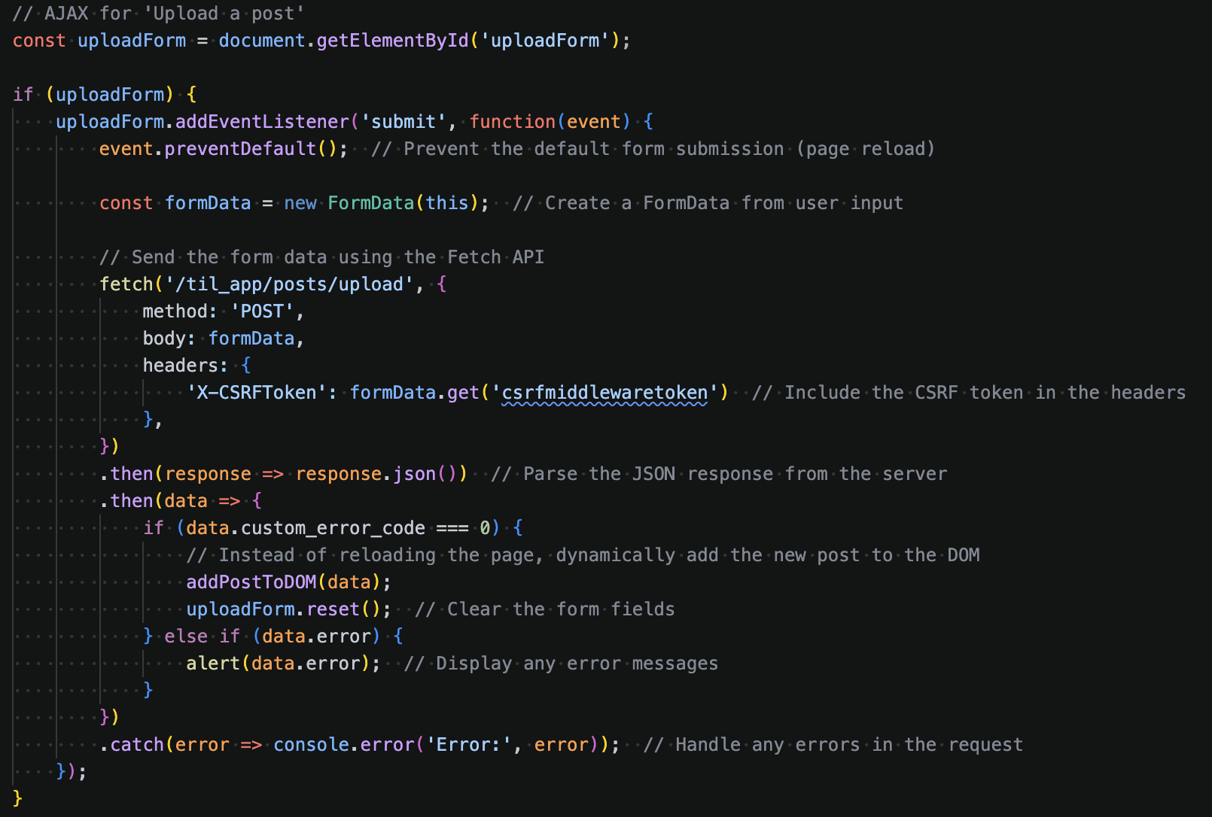
AJAX
How AJAX works
1. No normal form navigation
2. Background request
3.1 Request data
3.2 Django CSRF protection
4. Read server result
5. Update the DOM

Slide 10
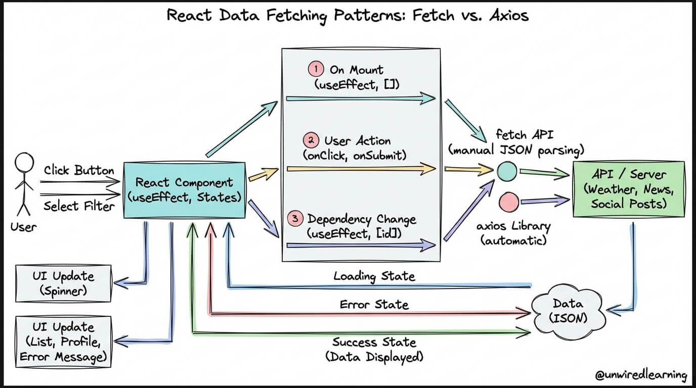
AJAX
Modern Frontend
Thinking in React @React
Fetching Data in React: Fetch vs Axios Best Practices @unwiredlearning
Notes:
“Finally, AJAX is not limited to raw JavaScript. Modern frameworks such as React still use Fetch or Axios to send asynchronous requests to a server.
The server returns data, usually JSON, and React stores the result as state. When that state changes, React updates the relevant interface automatically.
So the AJAX idea remains the same. React simply reduces the amount of manual DOM updating we need to manage.”

Slide 11
Database Selection

Slide 12
Database Selection
For Assignments
1. Database Choice
You may use any database of your choice (SQL or NoSQL).
Note: Django ORM natively supports relational databases (SQLite, MySQL, PostgreSQL).
There are third-party libraries for NoSQL (e.g., MongoDB), but check their stability before committing.
Recommendation: read this week’s tutorial + complete Individual Task 4 → play with Django ORM, then decide your DB.
2. Database Hosting
You may host your database on another server outside AWS Learner Lab.
However, frontend and backend must be deployed on AWS Learner Lab using Nginx + uWSGI.
Your backend can still connect to an external DB without issues.
3. Additional Notes on Remote DBs
For A2 (local testing): Tutors test your web app locally and need DB access.
Provide full credentials to your remote DB, or
Provide an SQL dump + clear re-creation instructions.
If tutors cannot access or create your DB locally → it may affect marks.
For A3 (deployment): Database may be hosted anywhere, but your AWS EC2 instance must allow terminal-based DB access (e.g., Supabase CLI, MongoDB shell). Tutors may need to query or modify your DB during marking.

Slide 13
Two Scoops of Django 3.x

Slide 14
Two Scoops of Django 3.x
Best Practices for the Django Web Framework
Greenfeld, D., & Roy Greenfeld, A. (2020). Two Scoops of Django 3.x: Best Practices for the Django Web Framework.
The book, while focused on Django 3, offers practical design ideas and best practices for structuring and optimising Django projects.
Read following chapters if you are not familiar with Python or Django project:
Chapter 1: Coding Style
Chapter 2: The optimal Django Environment Setup
Chapter 3: How to Lay Out Django Projects
Chapter 5: Settings and Requirements Files

Slide 15
Today’s Task
Read Lab 04 & complete Individual Task 4
Individual Task 4 is due in Week 6 Wednesday
Discuss your project idea and MVP with tutors
Make some wireframes and revisit your FRs
Tutors will mark your Individual Task 3 in person

